Slide 1
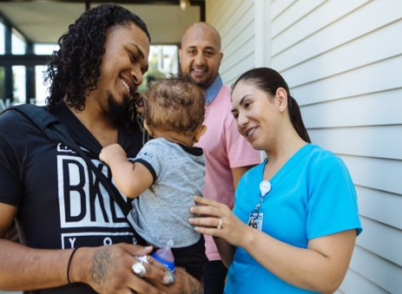
Structuring Systems to Promote Equity
Charter Revision Commission Urban Services District Subcommittee November 15, 2019
Devin Thompson Economic Development Officer

Slide 2
About LISC

Slide 3
Together with residents and partners, LISC forges resilient and inclusive communities of opportunity across America –great places to live, work, visit, do business and raise families.

Slide 4
LISC is an innovator, capacity-builder and convener with the ability to deploy capital for significant impact.
Pool public and private dollars
Work with local partners
Support people and places
By investing in housing, businesses, jobs, schools, public spaces, safety, youth, health centers, grocery stores and more, we catalyze opportunities in communities nationwide.
We raise funds from philanthropies, corporations and financial firms, federal, state and local governments and through the capital markets.
We also generate income from consulting, and lending services.
Through a network of local offices and community- based partners across the country, we provide grants, loans, equity and technical assistance.
We also lead advocacy efforts on local, regional and national policy.

Slide 5
Our Impact
$20 billion invested
$60 billion leveraged
S&P ‘AA’ Rating
$800 million
63 million square feet
376,000 homes
The only CDFI currently rated AA
Was the first CDFI to tap the general obligation bond market, with a $100 million issuance in 2017
Total Assets
Net worth has increased 48% in the past 4 years
Closed on more than $1.6 billion of debt transactions with NO defaults
Raised an average of $123 million annually in grants over the past 3 years
Square feet of commercial, retail and community space, including:
Early childhood centers
Schools
Fields/recreational spaces
Healthcare centers
Grocery stores
Financial Opportunity Centers
Affordable homes built and/or preserved including:
Multifamily rental
Supportive housing for special populations such as chronically homeless, LGBTQ, seniors and veterans
Affordable homeownership
Emphasize sustainability through green, healthy housing and transit oriented development

Slide 6
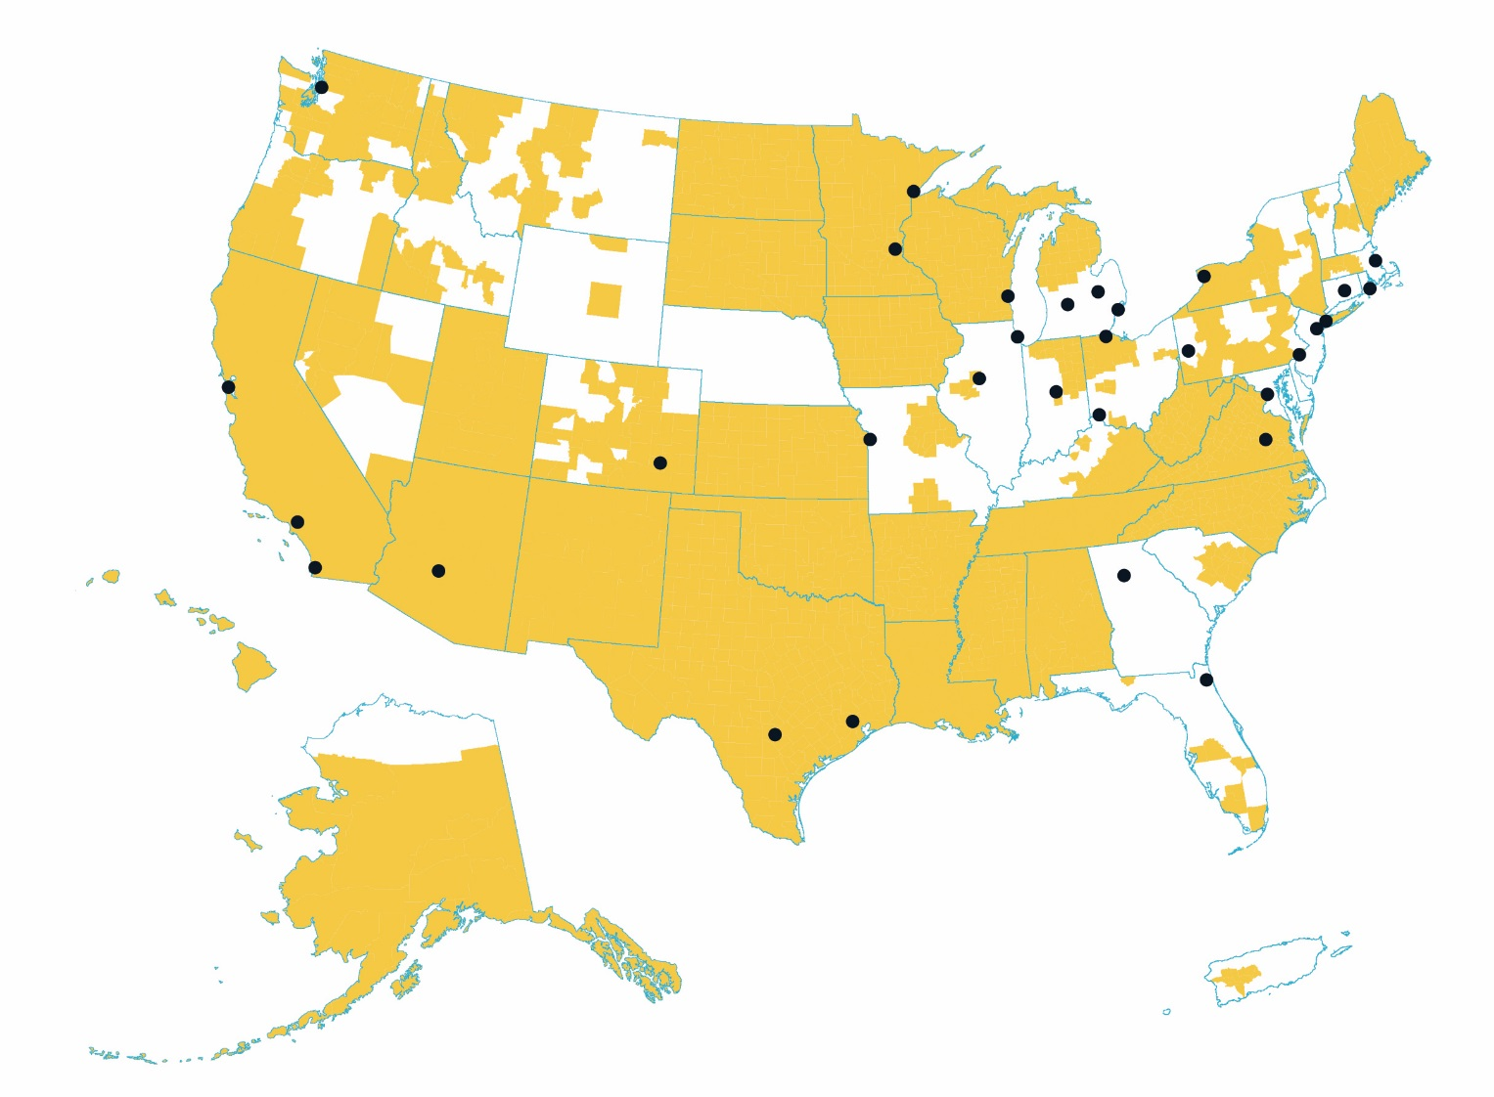
Our Reach
Office Locations
Atlanta, GA
Boston, MA
Buffalo, NY
Charlotte, NC
Chicago, IL (LISC, NEF, NMSC)
Cincinnati, OH
Detroit, MI
Duluth, MN
Flint, MI
Fowler, CO (Rural HQ)
Hartford, CT
Houston, TX
Indianapolis, IN
Jacksonville, FL
Kalamazoo, MI
Kansas City, MO
Los Angeles, CA
Milwaukee, WI
Minneapolis/St. Paul, MN
New York, NY
Newark, NJ
Peoria, IL
Philadelphia, PA
Phoenix, AZ
Pittsburgh, PA
Providence, RI
Richmond, VA
San Antonio, TX
San Diego, CA
San Francisco, CA
Seattle, WA
Toledo, OH
Washington, DC
2,000 Partners
Our national network includes nonprofits, businesses and government agencies in both rural and metropolitan areas
LISC office
Rural LISC footprint

Slide 7
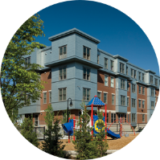
Opportunities
Equity in Infrastructure Investment
Empowering Urban Service District Residents
Support Mixed-Income, Mixed-Use Urban Communities

Slide 8
Infrastructure Investment

Slide 9
How Did We Get Here?
In 1960, Jacksonville was already an urban environment with mixed density. Nearly 200,000 residents lived in Urban Services District One, the Urban Core, with a population density (over 6,000ppl/sq mile) greater than Birmingham or Los Angeles and more in line with Indianapolis, Cincinnati, or St. Paul MN
Infrastructure Investment didn’t follow equitably to population after consolidation:
Road Management disproportionally directed to increasingly larger areas to create parity;
Lighting and public safety improvements initially focused on suburban-areas;
These active decisions further incentivized decentralization and development on the boundaries, where the infrastructure was more expensive to maintain, creating a cycle.

Slide 10
How We Can Correct That Disparity
Set Structural Guidance on Investment
Develop an Infrastructure Set Aside in the Capital Improvement Budget for Urban Services District One equal to 44.1% of the previous year’s CIP total.
Restrict the use of those dollars to:
Projects within Urban Services District One and zoned for Low-, Medium-, or High-Density Residential or Community General Commercial
Municipal Streets & Municipal Street Drainage Projects
This one change would have directed nearly $60 million in investment back to the Urban Core neighborhoods in 2019.
Expand Tax Increment Financing Opportunities
Develop guidance on an Urban Services District fractional TIF that would allow some smaller fraction of the increase in property tax values from redevelopment to support future redevelopment.
7

Slide 11
Empowering Residents

Slide 12
Community Benefits Agreements
What is a Community Benefits Agreement?
A Community Benefits Agreement (CBA) is a project-specific agreement between a developer and a broad community coalition that details the project’s contributions to the community and ensures community support for the project.
What is a Community Benefits Policy?
A community benefits policy is any policy adopted by a local government that requires community benefits on projects undertaken by the government or by a private developer. Common examples include living wage, local hiring, and affordable housing requirements for subsidized development.
What is a Multi-Parcel Standard? Or a Community Benefits Standard?
Local governments can proactively guide future growth by applying community benefits principles to large parcels of land slated for development or that seek to change their use from what the city had previously determined. If the land is government-owned or developed under an agreement with the local government, officials can incorporate community benefits into requests for proposals.
CBAs have an over 20-year track record of aligning the interests of neighborhood residents, government, and for-profit developers to allow the market to be a strong comp
Notes:
What is a Community Benefits Agreement?
A Community Benefits Agreement or "CBA" is a contract signed by community groups and a real estate developer that requires the developer to provide specific amenities and/or mitigations to the local community or neighborhood. Site-specific community benefits agreements (CBAs) ensure that particular projects create opportunities for local workers and communities. Often, however, these projects change the city's development paradigm; when decision makers realize what well-considered projects with specific benefits attached can bring to the community, the city enacts community benefits policies that set the stage for lifting thousands of people out of poverty.
Why the Community Benefits Model Works
Community benefits tools maximize returns on local government investment in development.
Community benefits programs can transform regions through stronger, more equitable economies.
Community benefits help generate public support for economic development projects.
Delivering community benefits is smart business.
CBAs hold developers accountable for their promises to local governments and residents.
Public input results in better projects that benefit the whole community and attract local customers.
Community benefits are part of a smart growth agenda.
Time is money, and projects with CBAs often enjoy a faster, smoother entitlement process.
What Is a CBA?
A Community Benefits Agreement (CBA) is a project-specific agreement between a developer and a broad community coalition that details the project’s contributions to the community and ensures community support for the project. Addressing a range of community issues, properly structured CBAs are legally binding and directly enforceable by the signatories.
In some cases, the community benefits terms from a CBA may be incorporated into an agreement between the local government and the developer, such as a development agreement or lease. That arrangement gives the local government the power to enforce the community benefits terms.
CBAs allow a win-win approach to development: meaningful, up-front communication between the developer and a broad community coalition decreases developers’ risk while maximizing the positive impact of development on local residents and economies. The developer benefits from active community support of the project, and community members gain when the project responds to their needs.
CBAs offer two important advantages over the traditional land use approval process. First, the process of negotiating a CBA allows for a more constructive and collaborative conversation about meeting community needs than the often adversarial and highly structured hearings that are part of a local government’s project approval process. Second, a private agreement is free from certain critical legal constraints that apply to government conditions on development projects, so the community and the developer may negotiate over a wide variety of deal points and come up with creative approaches.
Community benefits coalitions are long-term, broad-based groups with deep roots in the community. Coalitions typically represent a broad array of stakeholders, such as local residents across the income spectrum, people of all colors, representatives from labor, environmental and faith groups, and affordable housing advocates.
Community benefits coalitions recognize that high-quality new development is critical for expanding prosperity. Coalitions seek a role in shaping that development, and know that no one wins if the project fails.
CBAs Currently in Effect
What Is a Community Benefits Policy?
A community benefits policy is any policy adopted by a local government that requires community benefits on projects undertaken by the government or by a private developer. Common examples include living wage, local hiring, and affordable housing requirements for subsidized development.
Cities sometimes chose to adopt community benefits policies after successful projects with CBAs change the city's development paradigm. When decision makers realize what well-considered projects with specific benefits attached can bring to the community, the City enacts community benefits policies that set the stage for lifting thousands of people out of poverty.
Some local officials seeking to advance the use of CBAs in their cities have considered policies that require developers to negotiate CBAs. The Community Benefits Law Center generally advises against this approach for two reasons: (1) it is not clear who will negotiate on behalf of the “community” in such circumstances, and the process could be coopted by more well-connected and well-resourced interests; and (2) in the case of projects not receiving subsidy (or otherwise the subject of a government agreement), the CBA may be subject to the same set of legal constraints that govern conditions of project approval, limiting the kinds of community benefits that can be included.

Slide 13
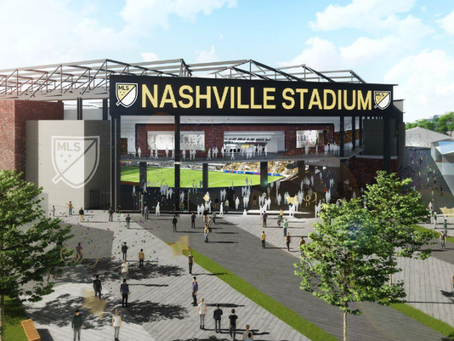
Community Benefit Agreements in Practice
$275 Million Project on the Nashville Fairground Site and development of proximate parcels for supportive mixed-uses – housing, retail, hotel, and entertainment.
CBA Completed in 2018 in parallel with the city rezoning the 10 acres of mixed-use development.
Major League Soccer Team met with Stand Up Nashville, a coalition of community groups, developed by the residents for the purpose of negotiating the CBA. Agents of both entities signed the contract and supported its
Notes:
Did I mention that it’s illegal in Tennessee for a city government to mandate affordable housing in private developments directly? CBAs served as a tool to indirectly create the outcome.
Nashville Soccer Stadium Development CBA: In 2018, Stand Up Nashville (SUN), a coalition of community, labor and faith-based groups, negotiated the first private Community Benefits Agreement in Tennessee on a proposed Major League Soccer (MLS) stadium development on the Tennessee State Fairgrounds. Nashville Soccer Holdings (a joint partnership between area investor John Ingram and MarketStreet Enterprises) are developing a 10-acre mixed use development adjacent to the 8-acre proposed $275 million 30,000-seat stadium for a new MLS team. Metro Nashville Government issued $255 million in revenue bonds for the stadium, $25 million in general obligation bonds for fairgrounds infrastructure upgrades and an additional $25 million for fairgrounds facility improvements. The ownership team, under a 30-year stadium lease agreement, would pay the city $25 million in cash and $9 million a year to pay off Metro’s stadium debt. Sales tax revenue and dollars from a ticket tax would make up the additional $4 million in annual $13 million debt payments. The city would be on the hook to pay the difference if the sales tax and ticket tax revenue fall short.
After months of intense negotiations and community organizing reached a landmark agreement that sets a new standard for development in Tennessee, that includes the following commitments:
Affordable Housing
20% of all housing units built at the development site will be set aside as Affordable and Workforce Housing
A commitment to 3 bedroom units that reflect the need for family housing in our city.
Wage Floor
NSH agrees to directly hire stadium workers (ushers, ticket takers, box office janitorial, custodial, maintenance, field maintenance employees) and pay them at least $15.50 an hour.
The establishment of a first-of-its kind targeted hiring program in Nashville with dedicated staff that will connect individuals with barriers to employment to future job opportunities at the stadium.
Community Services & Amenities
4,000 sq ft will go to a childcare facility, which will operate on a sliding scale.
4,000 sq ft will go to establishing micro-unit retail spaces for artisans and local small businesses at a reduced rental rate.
NSH will host annual coaching clinics for Metro School and other youth soccer coaches and donate soccer equipment to these programs.
Jobs and Workforce Development
Mandatory safety training for all construction workers and supervisors.
Leveling the playing field for responsible contractors that provide safe, thriving careers for their employees.
Construction careers for individuals with barriers to employment, especially from Promise Zones.
Inclusion of minority contractors.
Community Advisory Committee: A Joint Committee will be established with community representation. This Committee will oversee the implementation of the CBA, monitor successes, ensure compliance with the terms of the CBA, and produce an annual public report.

Slide 14
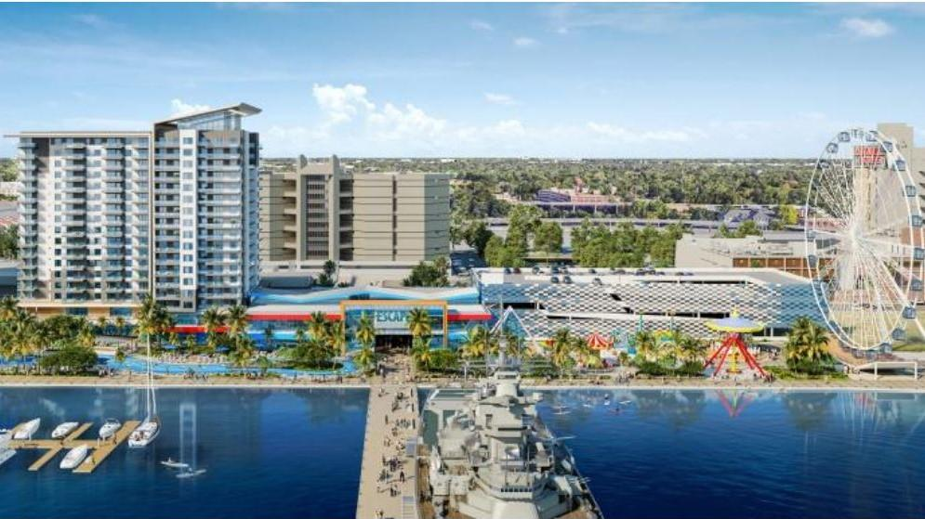
When Should We Mandate CBAs?
When Public Property is Being Developed.
Whether through transfer of public property by government or quasi-governmental entities, or land-leasing of parcels for development
When Public Financing is Sought for Private Benefit
When Agreed-upon Zoning is Being Changed
Zoning sets the baseline for what a community agrees should exist in their neighborhood. Any change through a Planned Unit Development or similar variance impacts that balance.
Notes:
Enable Extensive Community Involvement.
Actually delivering the right set of benefits to communities requires substantial community involvement. There are several ways that you can bring community into the process to achieve optimal results.
• Front End Input. As a local official, you can and should receive input from a wide range of stakeholders regarding community priorities related to development. Community residents and workers and groups that work with them provide a critical source of input and legitimacy around measures intended to benefit their communities. Engaging with these stakeholders as early as possible also promotes transparency around the project.
• Commitments to Community. Local governments can enter into cooperation agreements with community groups that protect those groups’ interests in the delivery of community benefits included in government agreements with developers.
• Ongoing Community Involvement. Often the community involvement phase of a process is at the front end, but the final deal (including many of the community benefits) is negotiated late in the day. Make sure you have a framework in place for ongoing community involvement, and are willing to create a process for the community input up until the final deal is cut.
• Community Oversight. Agreements can be used to establish a monitoring and oversight committee, with community membership. There are many ways to structure such committees, from purely advisory bodies to ones having true enforcement power.
• Community Enforcement. Elected and appointed officials are often rightly concerned that future administrations may not be as committed to enforcing community benefits commitments. Community groups and individuals can help ensure implementation and enforcement, if given the power. Living wage measures routinely provide direct enforcement rights to covered workers. Similarly, some affordable housing requirements provide enforcement rights to individuals living in rent-restricted units. In legal terms, these are third-party beneficiary provisions, and local governments can include them in contracts with developers or in conditions imposed on projects.

Slide 15
Community Benefits Agreements Aren’t Easy
What are the inputs needed for this strategy?
Community Organizing and Coalition Building
A Community Benefits Agreement (CBA) is a project-specific agreement between a developer and a broad community coalition that details the project’s contributions to the community and ensures community support for the project.
How do we build these inputs?
A community benefits policy is any policy adopted by a local government that requires community benefits on projects undertaken by the government or by a private developer. Common examples include living wage, local hiring, and affordable housing requirements for subsidized development.

Slide 16
Creating Diverse and Vibrant Neighborhoods

Slide 17
Supporting Affordable & Workforce Housing
Local Rent Supplement Program
Creating a local complement to HUD Section 8, as has been done in other jurisdictions, Jacksonville will be able to produce diverse housing without relying on the limitations of the state’s LIHTC process.
Tenant-based Program to pair with Section 8 to increase housing access;
Developer-based Program to create permanently affordable units;
Affordable Housing Trust Fund
Setting a fixe milage rate to support the ongoing replenishment of a Housing Trust Fund limited to funding CHDO’s multi-family housing development gaps.

Slide 18
Community Organizing and Community Planning
Jacksonville has made the most progress towards eliminating disparity when we’ve operated under multi-year jurisdiction-wide plans (Renaissance, Better Jacksonville, etc).
This multi-year initiatives start with neighborhood engagement, going back to Amelia Island Conferences and the Insight Committees as means to allow residents to have a say on their own quality of life.
Codifying the requirement for 5 to 10 year master planning initiatives, inclusive of land use review, human-services programing goals, and larger development of consensus-drive city-wide vision for growth and identity.
This role historically in Jacksonville has been led by either mayors, JCCI, or occasionally Non-profits. In other jurisdictions it’s most frequently completed as a partnership between government, neighborhood associations, and the nonprofit sector.
To be able to do this work successfully, community engagement, resident leadership, and collective agency need to become part of the structure that Jacksonville relies on to move forward together.

Slide 19
For further discussion, please contact:
Janet Owens Executive Director, LISC Jacksonville 904.351.0007 jowens@lisc.org
Devin Thompson Economic Development Officer, LISC 904.351.0009
dthompson2@lisc.org

